Slide 1
Chapter 13
Setting Up Your React Dev Environment Easily

Slide 2
Objectives
Meet Create React
Making Sense of What Happened
Creating Our HelloWorld App
Creating a Production Build

Slide 3
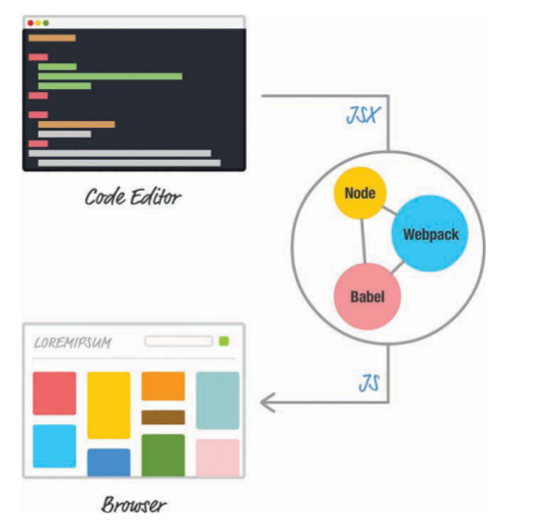
Meet Create React
The solution is to set up your development environment so that your JSX-to-JS conversion is handled as part of getting your app built.
With this solution, your browser is loading your app and dealing with an already converted (and potentially optimized) JavaScript file.

Slide 4
Meet Create React
To get started, first make sure you have the latest version of Node installed (https://nodejs.org/). Then bring up your favorite command line. If you aren’t too familiar with command lines, don’t worry.
The first thing you need to do is install the Create React project. Type the following in your command line and press Enter/Return:
npm install -g create-react-app

Slide 5
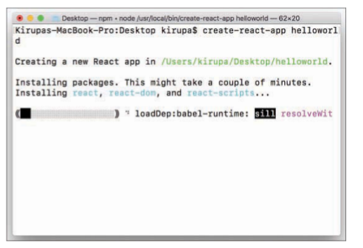
Meet Create React
When you’ve navigated to a folder in your command line, enter the following to create a new project at this location:
Navigate into the newly created project’s
cd helloworld
From inside this folder, enter the following to test the app:
npm start
create-react-app helloworld

Slide 6
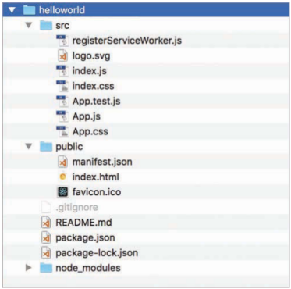
Making Sense of What Happened
File and folder structure after running create-react-app helloworld

Slide 7
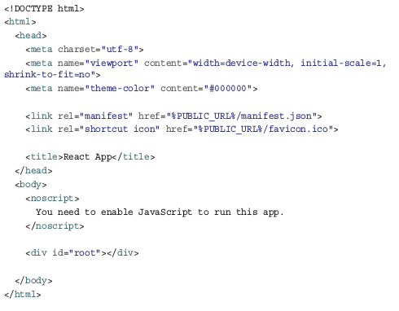
Making Sense of What Happened
The index.html in your public folder gets loaded in your browser. If you take a look at this file, you’ll realize that it’s very basic.

Slide 8
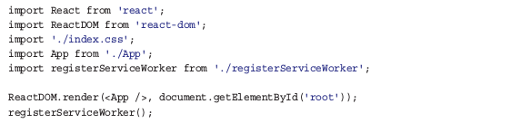
Making Sense of What Happened
The important part to look at is the div element with an id value of root . This is where the contents of our React app ultimately get printed to.

Slide 9
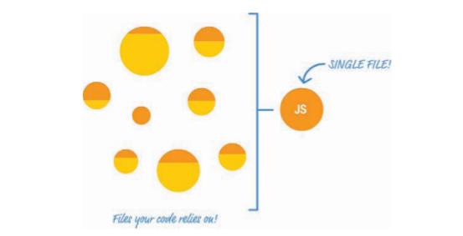
Making Sense of What Happened
The important point to note is that none of these things you are doing to your code affect the functionality of your final app in any major way. This build step makes sense of all of the various files and components you are importing, to present them as an easily digestible set of combined files for the browser to take care of.

Slide 10
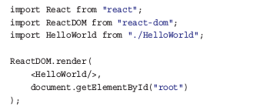
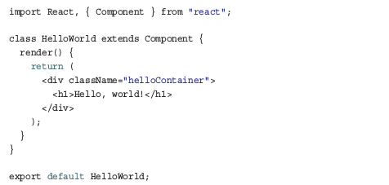
Creating Our HelloWorld App
To get started, go to your src directory and delete all the files you see there. Then create a new file called index.js
In the same src directory that we’re in right now, create a file called HelloWorld.js .

Slide 11
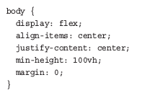
Creating Our HelloWorld App
Let’s fix that by adding some CSS. Create a stylesheet called index.css , and add the following style rule into it:
In this approach for building apps, creating the stylesheet is only one part of what you have to do. The other part requires you to reference the newly created index.css in the index.js file.

Slide 12
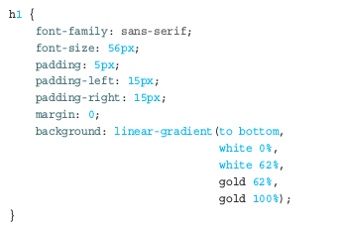
Creating Our HelloWorld App
Create a new file called HelloWorld.css inside the src folder. Add the following style rule into it:
Open that file HelloWorld.js and add the highlighted import statement:

Slide 13
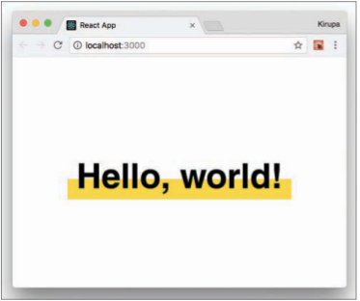
Creating Our HelloWorld App
If you go back to your browser, you know that everything worked out fine if you see something like the following:

Slide 14
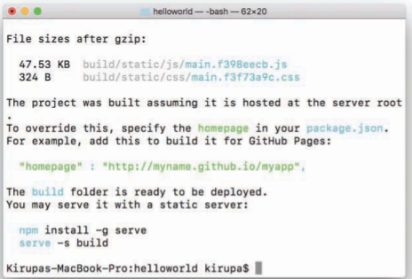
Creating a Production Build
The script takes a few minutes to create an optimized set of files for you. Once it has run to completion
Also take a moment to browse through all the files that were generated. The end result is just plain HTML, CSS, and JS files. No JSX. No multiple JS files. We have just a single JS file that contains all the logic our app needs to work.

Slide 15
Conclusion
We use the create-react-app command for future React examples; our earlier in-browser approach was just to help you learn the basics without fiddling with all of what you saw here.
Under the covers, Create React hides a lot of the complexity that goes with tweaking Node, Babel, webpack, and other components.
That is its greatest strength, as well as its greatest weakness.

